Slide 1
CYBER security
Fire wall
M.rajeshwari
Kavver engineering college

Slide 2
Network firewall.
Host-based firewall.
Hardware firewall.
Software firewall.
Internal firewall.
Distributed firewall.
Perimeter firewall.
Next-generation firewall

Slide 3
Network fire wall
A Firewall is a network security device that monitors and filters incoming and outgoing network traffic based on an organization’s previously established security policies. At its most basic, a firewall is essentially the barrier that sits between a private internal network and the public Internet. A firewall’s main purpose is to allow non-threatening traffic in and to keep dangerous traffic out.

Slide 4
Host based firewall
A host-based firewall is a piece of firewall software that runs on an individual computer or device connected to a network. These types of firewalls are a granular way to protect the individual hosts from viruses and malware, and to control the spread of these harmful infections throughout the network.

Slide 5
Hardware firewall.
A hardware firewall is a physical appliance that is deployed to enforce a network boundary. All network links crossing this boundary pass through this firewall, which enables it to perform inspection of both inbound and outbound network traffic and enforce access controls and other security policies.

Slide 6
Software fire wall
A software firewall is a firewall in a software form factor rather than a physical appliance, which can be deployed on servers or virtual machines to secure cloud environments. *Note: The term “software firewall” should not be confused with the term “firewall software,” which describes the operating system running a next-generation firewall (NGFW). Software firewalls are designed to protect data, workloads and applications in environments wherein it is difficult or impossible to deploy physical firewalls, including:

Slide 7
Types
Software-defined networks (SDN)
Hypervisors
Public cloud environments
Virtualized data centers
Branch offices
Container environments
Hybrid and multicloud environments

Slide 8
Internal firewall
Internal firewall
The Internal Network Firewall (INFW) is not a novel technology, but rather a subset of the Next Generation Firewall (NGFW) architecture. In most IT or hosted environments, traffic patterns can be classified as follows:

Slide 9
North to South: Traffic from LAN to the Internet and vice versa. East to West: Intra-organization traffic that routes server-to-server, server-to-client, or client-to-client but does not leave the organization. East-west traffic may occur between IP subnets or routed VLAN interfaces (typical in many enterprises with L3 switches). The majority of traffic in an organization or virtualized environment flows east to west.

Slide 10
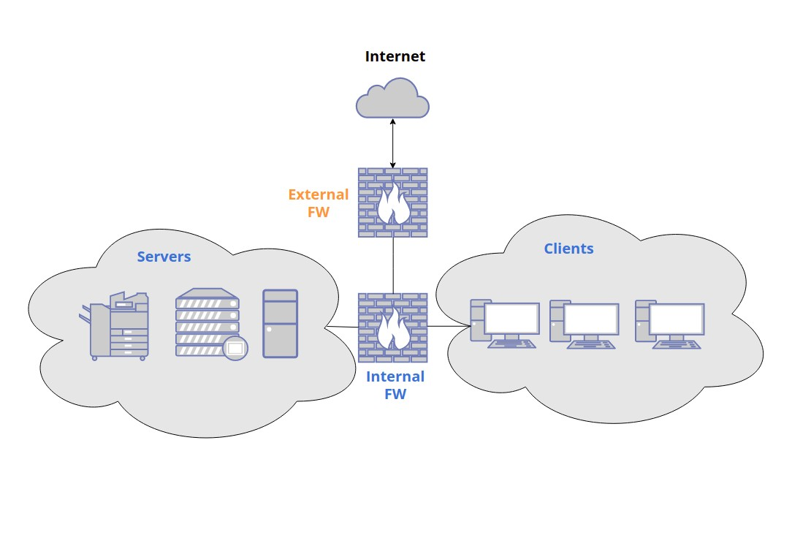
DIAGRAM

Slide 11
iNTErNAl firewall function
Using micro-segmentation, which splits the network into granular zones that are secured individually, the attack surface is reduced. Intelligent automation is being used to apply and update security policies based on “known good” behavior.

Slide 12
Distributed firewall
A distributed firewall is a security software application that protects an organization’s whole network against potential intrusions. It can be deployed alongside traditional firewalls to add further protection to the network and maintain a high level of throughput for network traffic.

Slide 13
Advantages of a Distributed Firewal
Protection from Insider Attacks A significant advantage of distributed firewalls is protecting hosts that are not within the traditional confines of enterprise networks. This is especially important with the rise of remote working and users accessing networks from disparate locations. A distributed firewall enables enterprises to protect user machines whenever and wherever they attempt to access networks

Slide 14
Intrusion Detection
Traditional firewalls typically do not understand the intention of a host and rely on the features of various protocols. This could lead to, for example, incoming Transmission Control Protocol (TCP) packets that originate from incoming attacks being presumed legitimate. However, sending hosts know the intention, so it is more secure to use distributed firewalls, which understand this intention and can reject illegitimate traffic.

Slide 15
Service Exposure and Port Scanning
Distributed firewalls ensure traffic throughput is no longer limited by firewall speed and eliminates the single point of failure that can isolate entire networks. Some enterprises attempt to address this by deploying multiple firewalls, which can result in an insecure firewall-to-firewall protocol.

Slide 16
Perimeter firewall.
A perimeter firewall refers to a security application that defends the boundary between a private network and a public network. Its goal is to prevent unwanted or suspicious data from entering the network. It protects against cyberattacks and other malicious traffic by scanning each data packet that tries to enter the network.

Slide 17
A perimeter firewall can also act as a proxy service, an intermediary between users and the internet, that allows greater access control by an administrator. As a perimeter firewall examines the content of the data packet, it can tell if it contains a threat based on the information in the packet’s header and the payload of the packet itself.

Slide 18
Network Perimeter
The network perimeter works as both a barrier and an entry point to the internet or an internal network to which it is connected. The perimeter of a network needs to be a secure boundary against cyberattacks.

Slide 19
import socket# Define the IP addresses to blockblocked_ips = ['10.0.0.1', '192.168.1.1']def main():
# Create a socket server_socket = socket.socket(socket.AF_INET, socket.SOCK_STREAM)
# Bind the socket to localhost and port 8080 server_socket.bind(('localhost', 8080))
# Listen for incoming connections
server_socket.listen(5) print("Firewall is running...")
while True:
# Accept incoming connection
client_socket, addr = server_socket.accept() # Check if the incoming connection IP is in the blocked list if addr[0] in blocked_ips:
print("Connection from blocked IP address:", addr[0])
client_socket.close() # Close the connection
else: print("Connection accepted from:", addr[0]) # Handle the connection (optional) # Implement your logic here # Close the connection client_socket.close()if __name__ == "__main__": main()

Slide 20


